Slide 1

H-1B Sponsorship Tracker
Group 3:
Eli Guo (yg2869)
Rocky Wang（zw2834)
Yao Zhang (yz4481)
Rohit Shivthare (rs4369)
Rutvi Shah (rs4357)
Krishna Thati (kt2878)
Link to the code

Slide 2
Introduction
Data Source and Procurement
Table of Contents
Technologies Used
Backend Integration
Frontend Integration/Website
Cost Estimation, Scalability and Potential Development
Notes:
Source images : Powerpoint Stock Images

Slide 3


1 Million+
International students
every year
~200K
Search for a job in USA post graduation
250-300
Average number of job applications per candidate
International Student
Problems:
Unnecessary Time invested in applying to “No Visa sponsorship” companies.
Lot of Rejections + Unsure about the Reasons.
Lowered Confidence
Candidate may move out of USA
JOB IN USA
I bet he is thinking about another girl
International Student
Does the company I applied to, provide H-1B sponsorship?
JOB IN USA
H-1B Sponsorship
THEN, WHAT’S THE SOLUTION ???
Zippia. "How Many Applications Does It Take To Get A Job? [2023]" Zippia.com. Feb. 6, 2023, https://www.zippia.com/advice/how-many-applications-does-it-take-to-get-a-job/

Slide 4
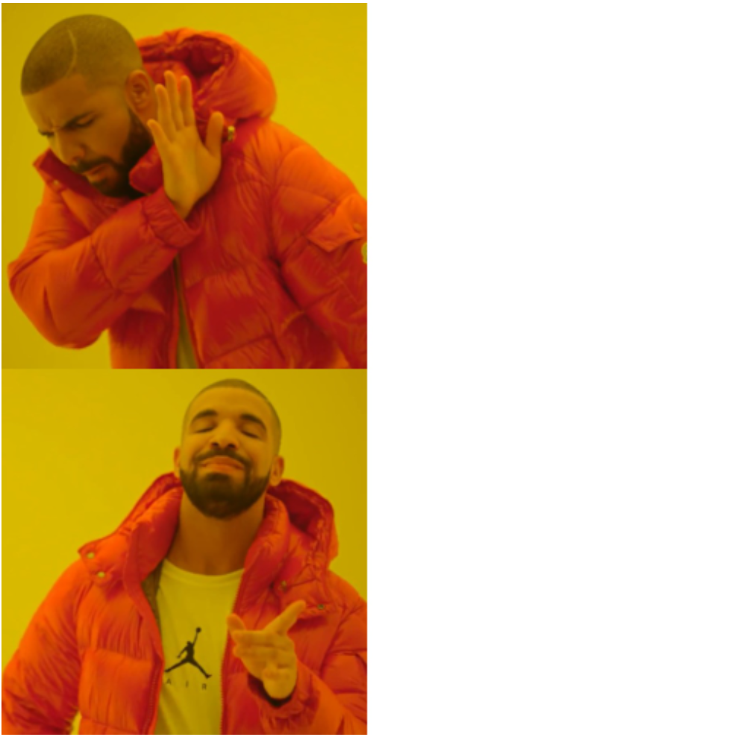
H-1B Sponsorship Tracker
A website where a candidate can search for companies that provides H-1B sponsorship for employees along with additional details such as Salary, H-1B dependent sponsorship and Contact details.
Doubts you might have:
Is the data on this website reliable?
Will you the data be UpToDate?
How does the website look like?
What all features are available for a user? Will you improve them in future?
How did you build this website?
What about Backend systems? Technologies used?
How much does this cost to build?
APPLY FOR A COMPANY AND WORRY ABOUT H-1B SPONSORSHIP/PRAY
GO TO “H1B SPONSORSHIP TRACKER” WEBSITE AND FIND OUT THE DETAILS
BE PATIENT WHILE WE ANSWER THESE QUESTIONS

Slide 5
Data Source and Procurement
Data Source:
United States Department of Labor (DOL) website - http://www.foreignlaborcert.doleta.gov/performancedata.cfm#dis
Data Procurement:
Downloading H-1B data from the DOL website for the past five years
Data Information:
Size: 1.6+ GB
2+ million entries, 100 columns
Data types: datetime64[ns](5), float64(10), int64(8), object(77)
The dataset contains information on visa applications. We select 9 categories of variables to create tables in the database, including case, job, employer, attorney/agent, website, wage, preparer, and others

Slide 6
Technologies Utilized
Data Preprocessing - (Pandas)
Remove NULL & duplicate values
2,074,099 -> 1,749,116 records
1.6+ GB -> 1.45 GB
Eradicating columns not required for our analysis
100 columns -> 10 columns
Backend - Relational database (SQL/PgAdmin/psycopg)
Create databases to store the H-1B data following integrity constraints
9 tables
Define the query generating function to fetch filtered results based on inputs
Frontend - Flask (HTML/CSS)
Build a search bar for inputs
Inputs -> job title, location, company
Add filters to further shrink the target roles
Filters -> case status, time frame, pay, H-1B dependent, full time

Slide 7
Backend Integration pt.1
H-1B Dataset with 100 unique columns
Data Cleaning
Case
Job
Employer
Attorney/
Agent
Worksite
Prevail Wage
Wage
Preparer
Others
Case info
Case number,
Status,
Date received,
VISA Class
Job Info
Job title,
Start date,
Start date,
Soc title,
Employer Info
Employer name,
City,
State,
Phone, number
Attorney Info
Representation,
Name,
Email,
Firm name
Site info
Worksite city,
Worksite, state
Prevail Wage Info
Prevail rate of pay,
Pay in the past
Wage Info
Rate of pay,
Unit of pay
Preparer Info
Name of preparer,
email
Extra Info
H-1B dependent,

Slide 8
Backend Integration pt.2
Inserting data into each formed table from the original data
Deciding on factors for searching and sorting
Generating query on the basis of parameter in SQL and returning the query to the frontend with the help of Javascript and Python functions

Slide 9
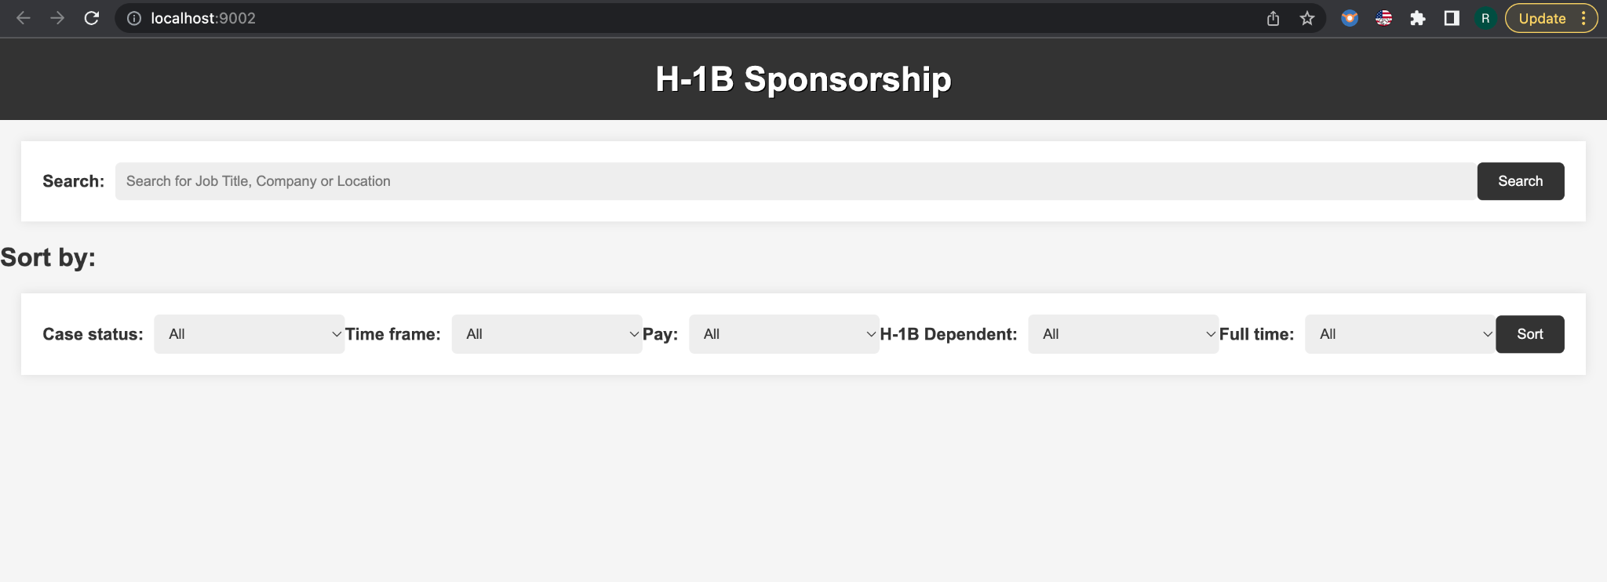
Front End Application
Search Box
[to search the company name, Job title (role) or Company location]
Sort/ Filter By
[to filter using Case Status, Time Frame, Pay, H-1B Dependent, Full time]

Slide 10
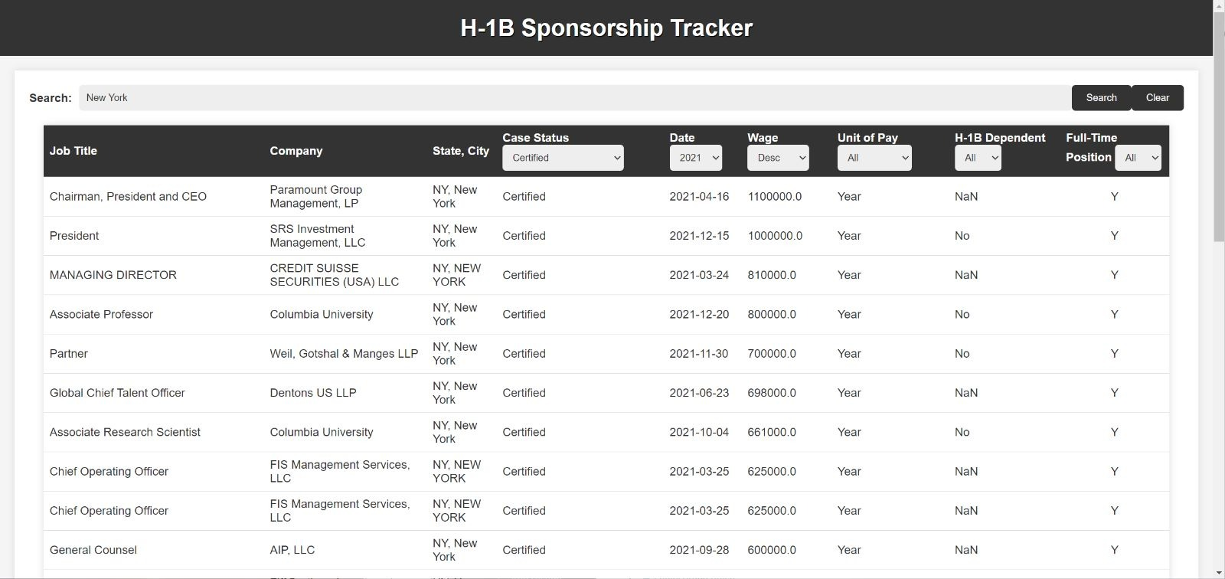
Search Results from a sample search by Location city

Slide 11
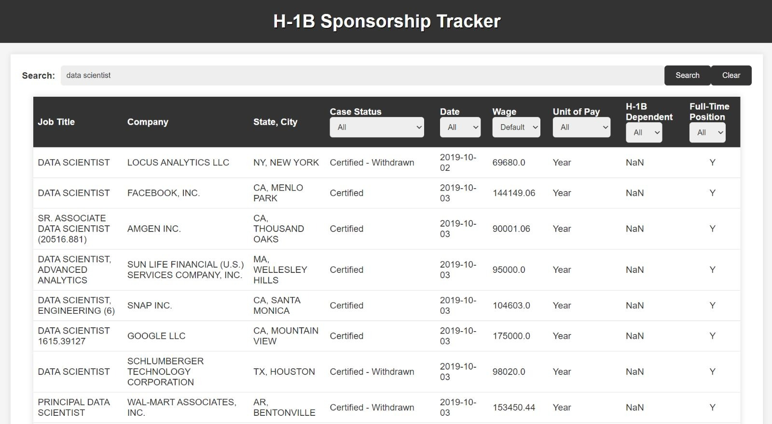
Search Results from a sample search by Job Title

Slide 12
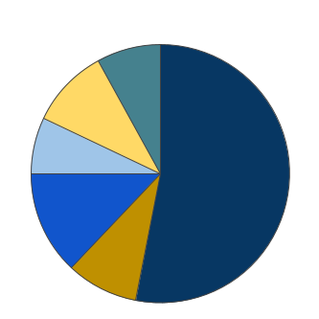
Cost Estimation and Division
Contingency Cost
$7k - $8k
$15k - $20k
Infrastructure cost
Marketing Cost
$10k - $15k
13%
7%
10%
9%
8%
$7k - $8k
Third party Integration
53%
Development
Maintenance and Support
$10k - $12k
$60k - $80k
Overall Estimation - $110k - $145k

Slide 13
Scalability
The availability of huge dataset makes it easy for the developers to change the parameters according to the market’s need.
The Database is designed to handle a large volume of data and be optimized for fast querying, to allow for scalability in the data storage and retrieval process.
The API can be designed on top of another working application to inculcate and combine them to create a bigger marketplace.
The interactive dashboard is designed to handle a large amount of data and be optimized for fast rendering, to allow for scalability in the presentation of data to users

Slide 14
Potential Development
The API can be built as an extension on websites like Linkedin to provide users knowledge of if the company provides sponsorship.
It can also introduce application on the portal itself
To provide more accurate and real time updates information.
It can be personalized to provide alerts on the basis of users choice.
Integration with government system
Personalized Alerts
Introduce Applications
Linkedin
1
2
3
4

Slide 15
Thank You
FINALLY, A Happy FAM…Yay!
Oh wait! I forgot something
Honey! Are you thinking about any other girl?
No Honey. As I got the job, I am just thinking of us going on a vacation for our anniversary
What happened to the couple shown earlier? Let’s find out
Any Further Questions?

